Slide 1
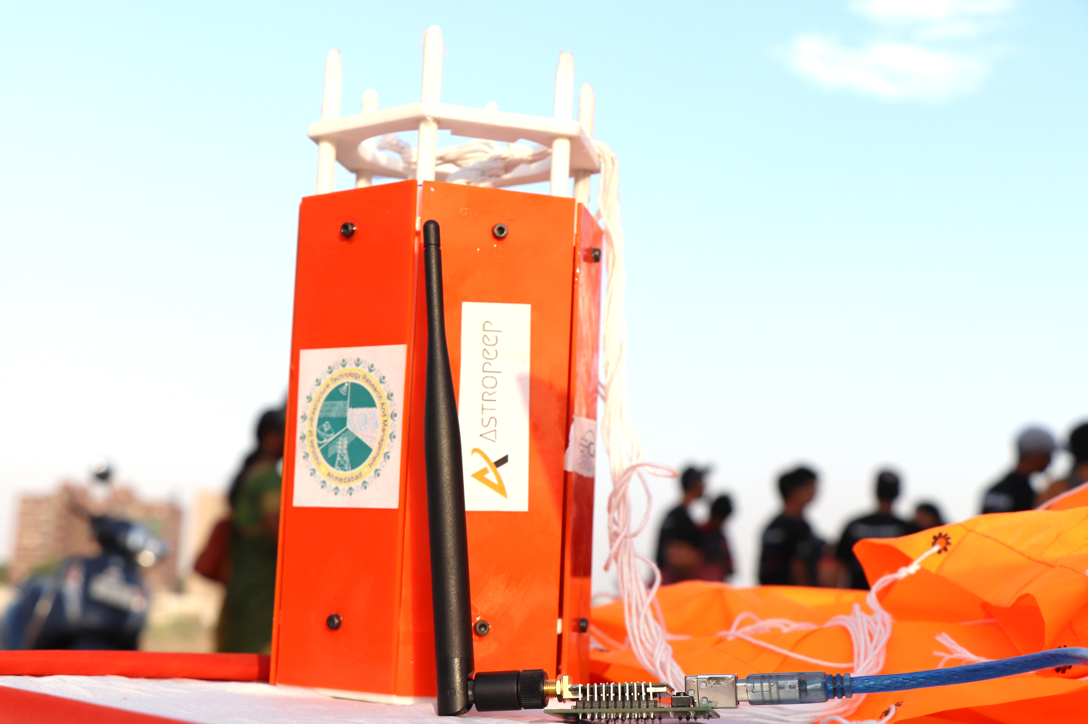
CanSat Data Analysis

Slide 2
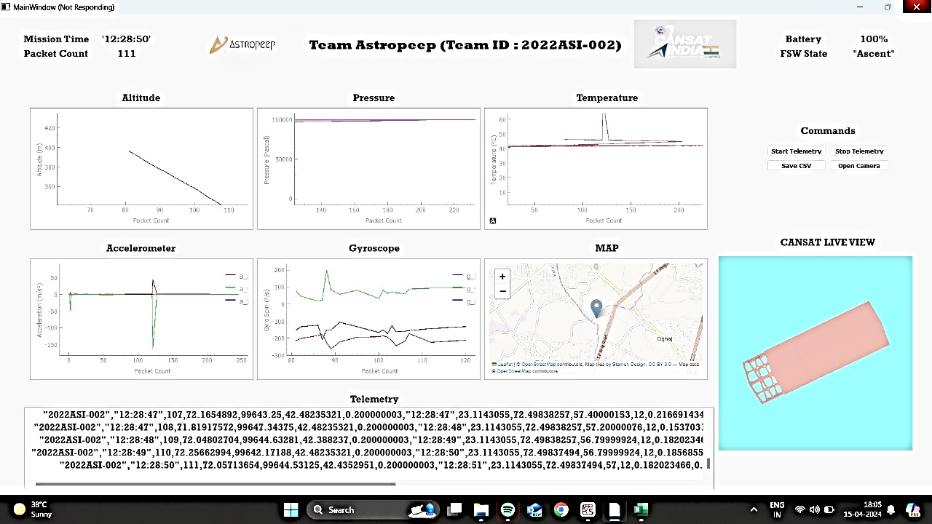
CanSat Real time Collected Data

Slide 3
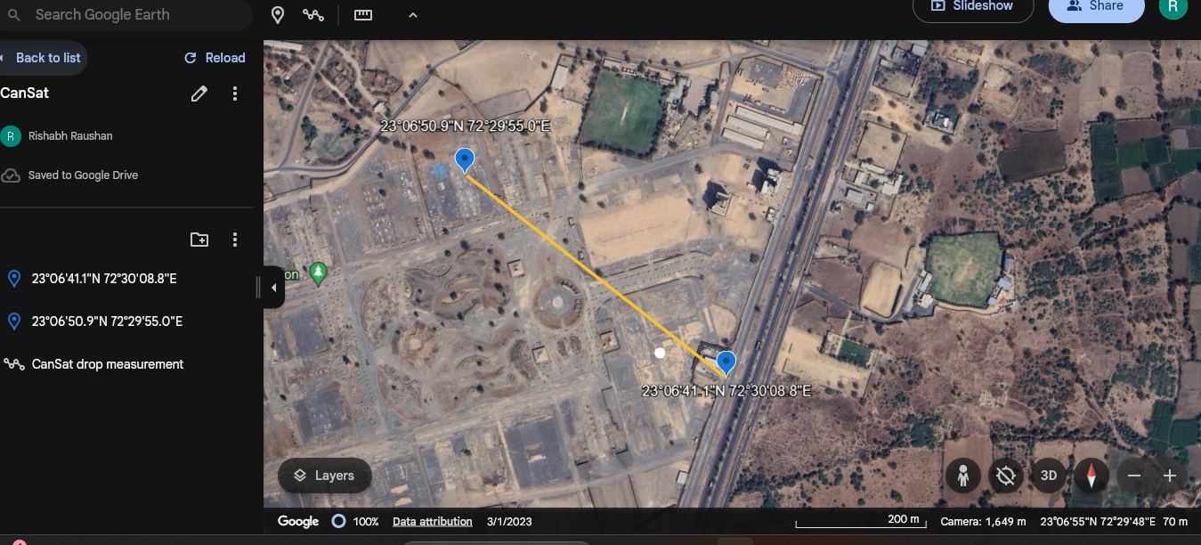
CanSat Launch and Recovery Distance
Distance Covered = 493.2 m

Slide 4
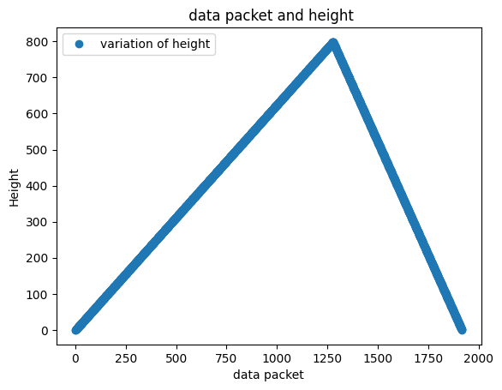
Variation in Height

Slide 5
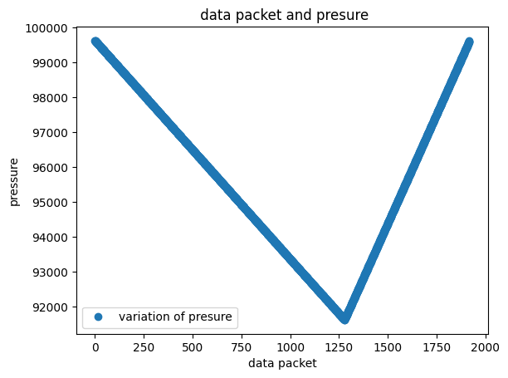
Variation in Pressure

Slide 6
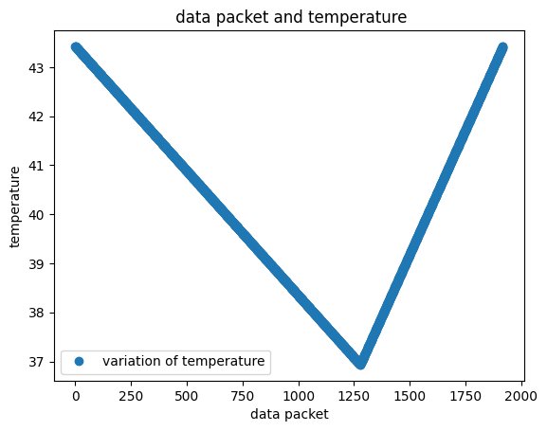
Variation in Temperature

